Slide 1
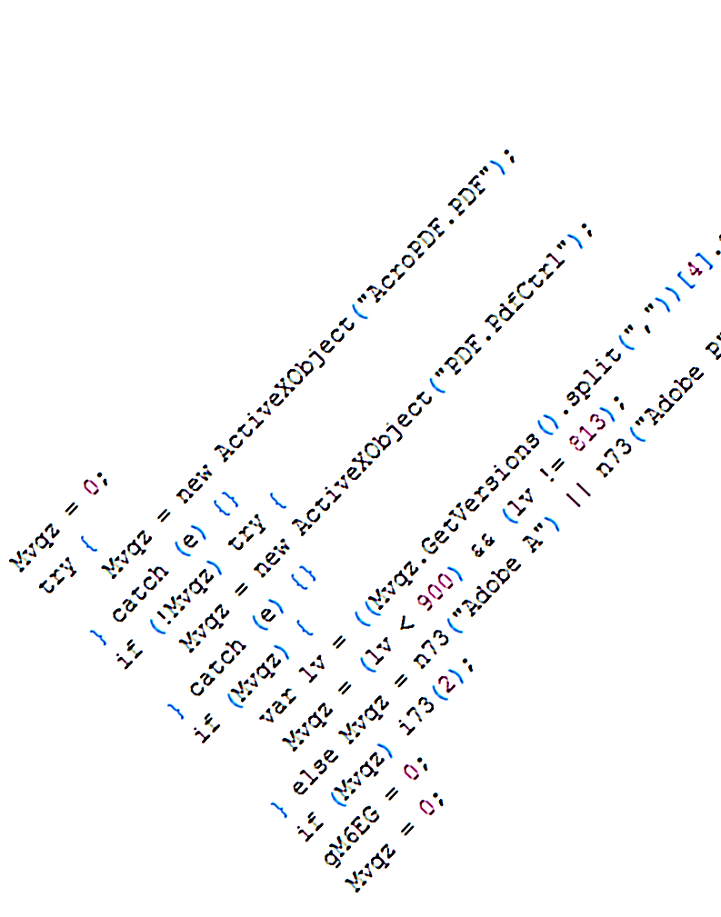
Rozzle
De-Cloaking Internet Malware
Ben Livshits
with
Clemens Kolbitsch, Ben Zorn,
Christian Seifert, Paul Rebriy
Microsoft Research

Slide 2
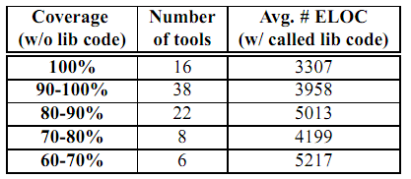

Static – Dynamic Analysis Spectrum
+ High precision
- High overhead
- Low coverage
+ High precision
+ High scalability
+ High coverage
- Watch out for resource usage
DART, SAGE, KLEE
+ High precision
+ Scales reasonably well
? High coverage
+ High coverage
- Low precision
- May not scale
Entirely static
Symbolic execution
Entirely runtime
Multi-execution

Slide 3
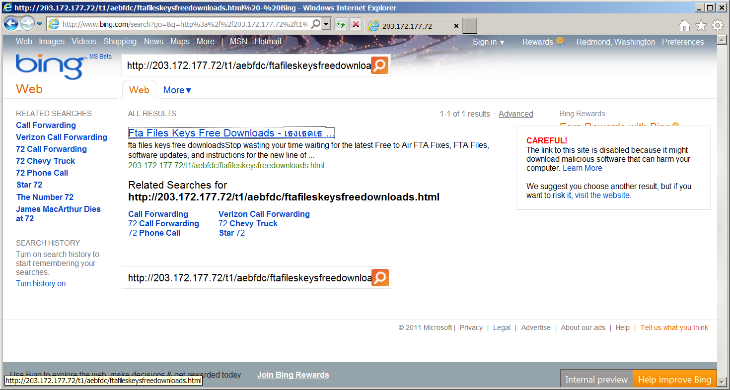
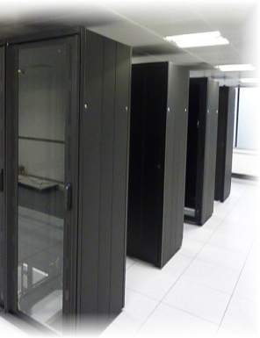
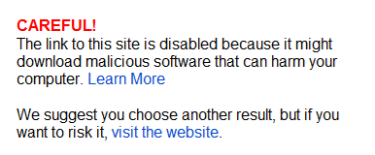

Blacklisting Malware in Search Results

Slide 4
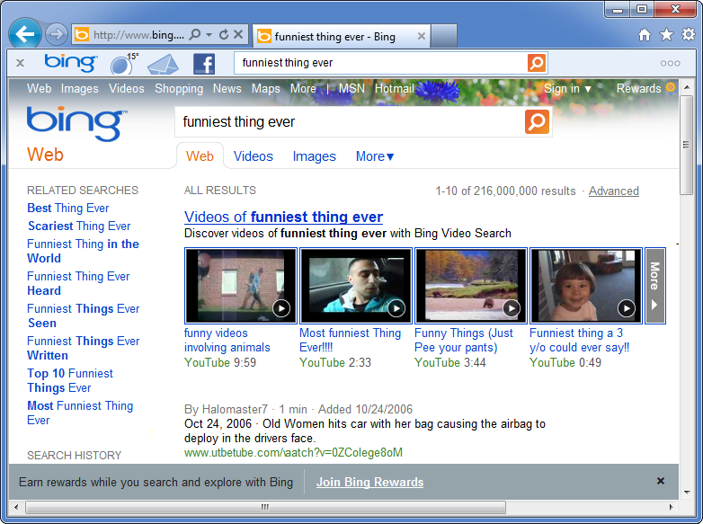

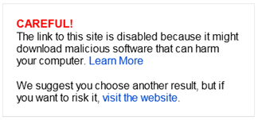
Motivation
Haha, I cannot belive this guy actually does this!! LOL
Notes:
So, let’s talk about I have been doing over the last weeks here in Redmond whenever it was not raining..
I think we all agree that a large fraction of Internet users will readily click on any link that is shown to them (show link), despite the harm that visiting a malicious site do to their computer and private data.
Although some of us Darwinists might claim that it is the user’s own fault and not our problem, this is clearly not the case when Bing suggests such a link as search result to a user. (show Bing-picture)
For this reason, the major Search engines – including Bing and Google – have started analyzing the links they include during their indexing of the web for malicious content. (show Bing-warning-picture TODO)
In this line of work, MSR and the Bing malware team have started two very successful projects – Nozzle in 2009 and Zozzle last year. Clearly, authors of malicious websites are not sleeping and try to fight the filtering that is done. Rozzle – this project I have been working on during my internship – continues in the line of Nozzle and Zozzle and improves filtering of malicious links from search engine results.

Slide 5
Drive-by Malware Detection Landscape
offline
(honey-monkey)
online
(browser-based)
Instrumented browser
Looks for heap sprays
Moderately high overhead
Nozzle
[Usenix Security ’09]
runtime
static
Mostly static detection
Low overhead, high reach
Can be deployed in browser
Zozzle
[Usenix Security ’11]

Slide 6



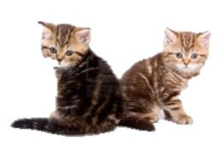
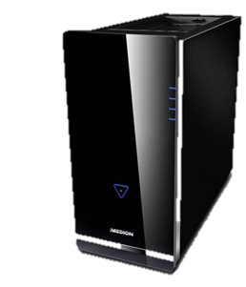


Search Engine Crawling
Notes:
So, let’s take a look at what authors of malicious sites currently do to avoid being detected and blacklisted by tools such as Nozzle and Zozzle. Here, we see the indexing of a benign website and some user visiting it.
As you can see, when the Bing crawler or the user visits the site – www.kittens.info in this case – some information about cats is returned, just as one would expect it.

Slide 7



Malware Cloaking
<script>
if (navigator.userAgent.indexOf(‘IE 6’)>=0)
{
var x=unescape(‘%u4149%u1982%u90 […]’);
eval(x);
}
</script>
Fingerprint browser & plugin versions
Do this using JavaScript
Client side
Source IP
Request (User-Agent, Browser ID)
Server side
detect vulnerable target
detect crawler
Notes:
However, one technique used by attackers today is called ‘Cloaking’. Cloaking means to return a different page to different types of users.
In our scenario this would mean returning a allegedly harmless site to the Bing crawler (so the site is not blacklisted), but when a real user visits the same site, the site delivers some sort of exploit and tries to attack user’s browser. If successful, the exploit will install some malware program that will then do whatever the attacker tells it to.
In cloaking, we usually distinguish between two forms: Server side cloaking versus client side cloaking.

Slide 8






Client-side Cloaking Defense
Rozzle
Traditional
Single browser, one visit
Appear as vulnerable as possible
Notes:
So, how do you normally work around client-side cloaking? There are 2 options: Either you visit them with the oldest and most outdated browser you can come up with. This helps to some degree, but is not very satisfactory. Second, you can visit a URL with a whole set of different browser configurations. While this is better than the first approach, it does not solve the problem either as we will see later.
The solution we came up with during our work on Rozzle is the following: We only visit the site once, with a browser that supports multiple profiles simultaneously. This makes the browser look as vulnerable as possible and should trigger as much malicious activity as we there is.
In the rest of this talk, I’ll go into more detail on the problem and how we design and implemented Rozzle.

Slide 9
Overview
Background & Motivation: Cloaking
Detecting Internet Malware
Rozzle: Fighting Evasion
Experiments

Slide 10
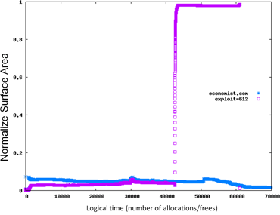
Detecting Internet Malware
Nozzle: A Defense Against Heap-spraying Code Injection Attacks
[Usenix Security 2009]
Scan heap allocated objects to identify valid x86 code sequences
Zozzle: Low-overhead Mostly Static JavaScript Malware Detection
[Usenix Security 2011]
Bayesian classification of hierarchical features of the JavaScript abstract syntax tree. In the browser (after unpacking)
Dynamic Detection
Nozzle
Static Detection
Zozzle

Slide 11
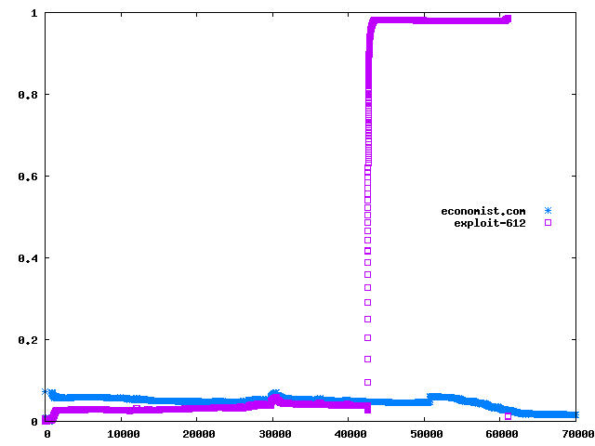
Nozzle: Runtime Heap Spraying Detection
Normalized attack surface (NAS)
good
bad

Slide 12
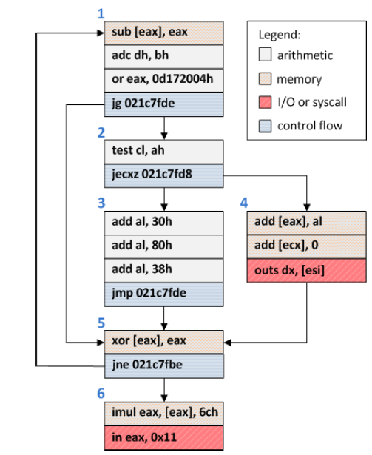
Object Surface Area Calculation
4
4
12
Each block starts with its own size as weight
Weights are propagated forward with flow
Invalid blocks don’t propagate
Iterate until a fixpoint is reached
Compute block with highest weight
2
6
12
4
10
3
9
12
15
2
12
12
2
14
14
An example object from visiting google.com
12

Slide 13
Zozzle: Static/Statistical Detection
// Shellcode
var shellcode=unescape(‘%u9090%u9090%u9090%u9090%uceba%u11fa%u291f%ub1c9%udb33 […]′);
bigblock=unescape(“%u0D0D%u0D0D”);
headersize=20;shellcodesize=headersize+shellcode.length;
while(bigblock.length<shellcodesize){bigblock+=bigblock;}
heapshell=bigblock.substring(0,shellcodesize);
nopsled=bigblock.substring(0,bigblock.length-shellcodesize);
while(nopsled.length+shellcodesize<0×25000){nopsled=nopsled+nopsled+heapshell}
// Spray
var spray=new Array();
for(i=0;i<500;i++){spray[i]=nopsled+shellcode;}
// Trigger
function trigger(){
var varbdy = document.createElement(‘body’);
varbdy.addBehavior(‘#default#userData’);
document.appendChild(varbdy);
try {
for (iter=0; iter<10; iter++) {
varbdy.setAttribute(‘s’,window);
}
} catch(e){ }
window.status+=”;
}
document.getElementById(‘butid’).onclick();
shellcode unescape
bigblock unescape %u0D0D%u0D0D
shellcodesize shellcode.length
bigblock.substring shellcodesize
nopsled bigblock.substring bigblock.length shellcodesize
nopsled.length shellcodesize nopsled nopsled nopsled heapshell
spray
spray nopsled shellcode
varbdy.addBehavior #default#userData
document.appendChild varbdy
varbdy.setAttribute
butid

Slide 14
Naïve Bayes Classification
eval(""+O(2369522)+O(1949494)+O(2288625)+O(648464)+O(2304124)+O(2080995)+O(2020710)+O(2164958)+O(2168902)+O(1986377)+O(2227903)+O(2005851)+O(2021303)+O(646435)+O(1228455)+O(644519)+O(2346826)+O(2207788)+O(2023127)+O(2306806)+O(1983560)+O(1949296)+O(2245968)+O(2028685)+O(809214)+O(680960)+O(747602)+O(2346412)+O(1060647)+O(1045327)+O(1381007)+O(1329180)+O(745897)+O(2341404)+O(1109791)+O(1064283)+O(1128719)+O(1321055)+O(748985)+...);
Feature | P(malicious)
string:0c0c | 0.99
function:shellcode | 0.99
loop:memory | 0.87
Function:ActiveX | 0.80
try:activex | 0.41
if:msie 7 | 0.33
function:Array | 0.21
function:unescape | 0.45
loop:+= | 0.55
loop:nop | 0.95
*
P(malicious)

Slide 15
Overview
Background & Motivation: Cloaking
Detecting Internet Malware
Rozzle: Fighting Evasion
Experiments

Slide 16









Environment Fingerprinting Prevents Detection
Nozzle
Zozzle
<script>
var adobe=new ActiveXObject(‘AcroPDF.PDF’);
var adobeVersion=adobe.GetVariable (‘$version’);
if (navigator.userAgent.indexOf(‘IE 6’)>=0 &&
adobeVersion == ’9.1.3’)
{
var x=unescape(‘%u4149%u1982%u90 […]’);
eval(x);
}
</script>
In 7.7% of JS files, code gets a reference to environment
In 1.2%, code branches on such sensitive values
89.5% of malicious JS branches on such values
<script>
if (navigator.userAgent.indexOf(‘IE 6’)>=0)
{
var x=unescape(‘%u4149%u1982%u90 […]’);
eval(x);
}
</script>
Is this a practical problem for our malware detectors?

Slide 17
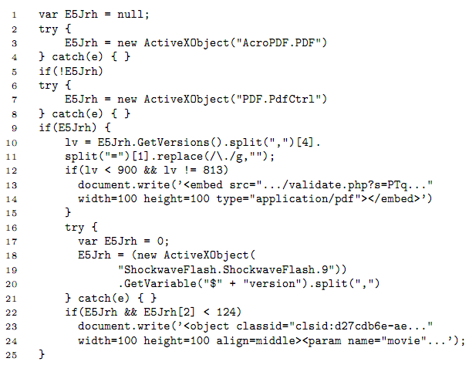
Typical Malware Cloaking

Slide 18
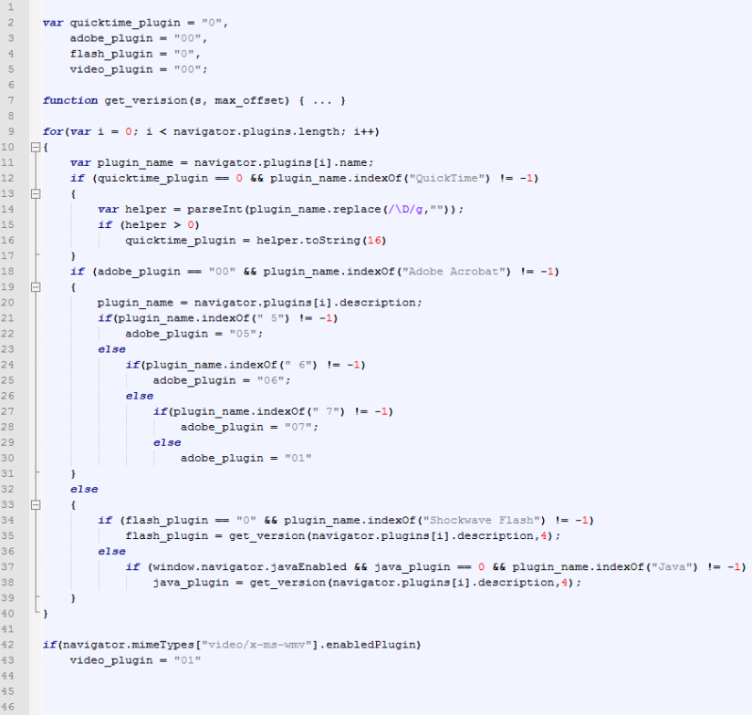
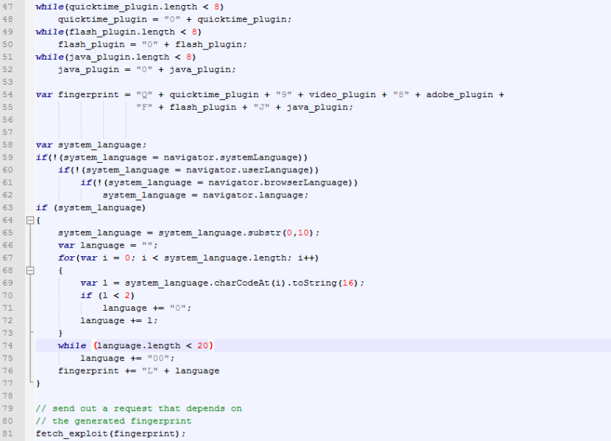
More Complex Fingerprinting
Fingerprint: Q0193807F127J14

Slide 19
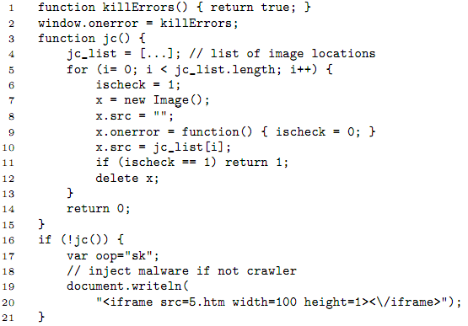
Avoiding Dynamic Crawlers

Slide 20
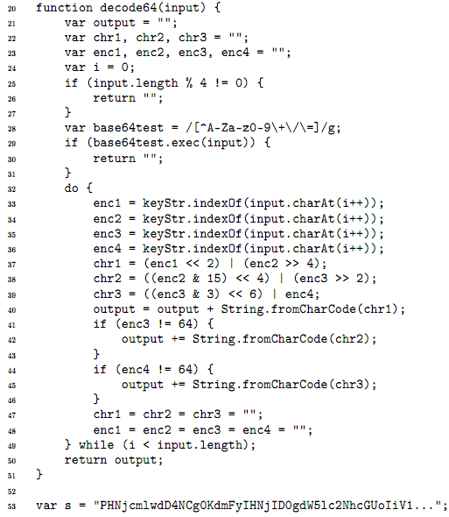
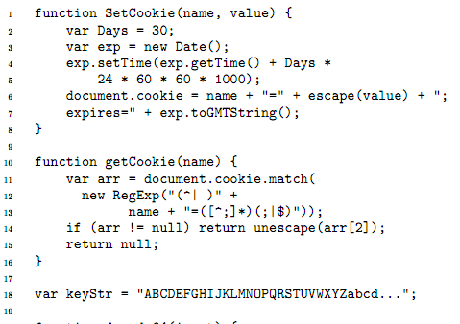
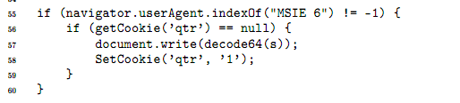
Avoiding Static Detection

Slide 21








How to Allocate Detection Resources?
Rozzle
1.4
1.5
2.0
…
9.0
9.1
10.0
…
Clearly does not scale
How many resources should be allocated to filter malicious sites?
What if the site simply is
not malicious?
8
9
10

Slide 22
Rozzle
Multi-path execution framework for JavaScript
What it is/does
What it is not
Multiple browser profiles on single machine
Cluster of machines: too resource consuming
Branch on environment-sensitive checks
No forking
No snapshotting
Symbolic execution: re-verting to a previous state similar to running multiple browsers in parallel
Execute individual branches sequentially to increase coverage
Static analysis: Retain much of runtime precision
Notes:
Last point: mention path coverage

Slide 23
Multi-Execution in Rozzle
<script>
var adobe=new ActiveXObject(‘AcroPDF.PDF’);
var adobeVersion=adobe.GetVariable (‘$version’);
if (navigator.userAgent.indexOf(‘IE 7’)>=0 &&
adobeVersion == ’9.1.3’)
{
var x=unescape(‘%u4149%u1982%u90 […]’);
eval(x);
}
else if (adobeVersion == ’8.0.1’)
{
var x=unescape(‘%u4073%u8279%u77 […]’);
eval(x);
}
…
</script>
Notes:
Stress the fact that we go into the else TOO!

Slide 24
Challenges
Consistent updates
of variables
Handling loops
Introduce concept of Symbolic Memory:
Multiple concrete values associated with one variable
New JavaScript data type Symbolic
  3 subtypes
  symbolic value / formula / conditional
Weak updates for conditional assignments
Indirect control flow: Exception handling
I/O

Slide 25
Symbolic Memory
Variable : userAgentString
Value : 0
Symbolic : no
Variable : userAgentString
Value : < navigator.userAgent >
Symbolic : yes
<script>
var userAgentString=0;
userAgentString = navigator.userAgent;
var isIE;
isIE = (userAgentString.indexOf(‘IE’)>=0);
…
Hooks into engine, return symbolic values for
Sensitive global objects: navigator.userAgent, navigator.platform, …
Sensitive functions: ScriptEngine(), allocation of ActiveXObject, …
Variable : isIE
Value : < navigator.userAgent. indexOf(‘IE’) >= 0 >
Symbolic : yes

Slide 26
Symbolic Memory
Variable : isIE
Value : < nav.userAgent.indexOf(…)>=0 > ? true : false
Symbolic : yes
Variable : isIE
Value : false
Symbolic : no
<script>
var isIE=false;
var isIE7=false;
if (navigator.userAgent.indexOf(‘IE’)>=0)
{
isIE=true;
if (navigator.userAgent.indexOf(‘IE 7’)>=0)
{
isIE7=true;
}
}
if (isIE7)
{
…
Variable :
isIE7
Value :
false
Symbolic :
no
Variable :
isIE7
Value :
<…>
Symbolic :
yes
Current path predicate
Value : < nav.userAgent.indexOf(..)>=0 >
Symbolic : yes
Current path predicate
Value : < nav.userAgent.indexOf(..)>=0 > &&
< nav.userAgent.indexOf(..)>=0 >
Symbolic : yes

Slide 27
Symbolic Memory
?
Variable : isIE
Value : < nav.userAgent.indexOf(…)>=0 >
? true : false
Symbolic : yes
true
>=
false
0
indexOf
navigator.
userAgent
‘IE’
Notes:
End with: We believe the use of symbolic memory is fairly novel and could be used in other scenarios too. Further, this can be implemented in any language supporting dynamic types

Slide 28
Challenges
Consistent updates
of variables
Consistent updates
of variables
Handling loops
Handling loops
  try-blocks regularly used to test availability
  of plugins (ActiveXObjects)
  catch-blocks set default values, cannot be ignored
  Execute catch-statement similar to else branch, add virtual if-condition: “ActiveX supported”
  Handling symbolic values when they are…
    … written to the DOM
    … sent to a remote server
    … executed (as part of eval)
  Lazy evaluation to concrete values (only when needed)
  Loop condition might be symbolic, number of iterations unknown!
  Unroll k iterations (currently k=1)
  Instruction pointer checks (endless loops/recursion)
I/O
Indirect control flow: Exception handling
Indirect control flow: Exception handling

Slide 29



Experiments
Offline
Controlled Experiment
7x more Nozzle detections
Online
Similar to Bing crawling
Almost 4x more Nozzle detections
10.1% more Zozzle detections
Overhead
1.1% runtime overhead
1.4% memory overhead
Notes:
Overhead: these are the 80th percentile numbers

Slide 30
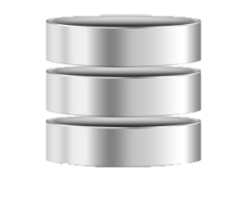
Offline
Exploits hosted on our server
Minimize external influences
70,000 known malicious scripts (flagged by Zozzle)
Fully unrolled/de-obfuscated exploits, wrapped in HTML
+595% runtime detections
Notes:
Stress HOW we got the dataset: Zozzle might confuse
Stress WHAT we are detecting: New Nozzle detections

Slide 31
Online
Dedicated machine for crawling the web
Clone of the Bing malware crawler
List of URLs recently crawled by Bing
Pre-filtering: Increase likelihood of finding malicious sites
57,000 URLs over the last week
Nozzle Detections
Zozzle Detections
24
225
50
156
174
2,510
+203% runtime detections
Notes:
Zozzle detections: Yes we have problems, but that’s because of the online style and the way we do it and the new system

Slide 32
Online
Dedicated machine for crawling the web
Clone of the Bing malware crawler
List of URLs recently crawled by Bing
Pre-filtering: Increase likelihood of finding malicious sites
57,000 URLs over the last week
2758
2600 2700 3000 3100 3200 3300
Notes:
Describe what the BASE is (Nozzle AND Zozzle)
Added by Nozzle: ~3%
Base run: 31% of Nozzle detections not detected by Zozzle
Total: 8.2% more detection with Rozzle
+5.7% new static detections if taking the large numbers

Slide 33
Overhead
Average numbers of 3 repeated runs per configuration
Base runs (cookie setup)
500 randomly selected URLs crawled by Bing
Slightly biased towards malicious sites (pre-filtering)
Runtime Overhead
Median: 0.0%
80th Percentile: 1.1%
Memory Overhead
Median: 0.6%
80th Percentile: 1.4%

Slide 34
Overhead Numbers
1.0
Notes:
Performance distribution. Long tail adds up to 11.8% runtime overhead

Slide 35
Take Away
For most sites, virtually no overhead
Tremendous impact
on runtime detector due to increased
path coverage
Visible impact on
static detector
More important with growing trend to obfuscation
Also improves other existing tools: Exposes detectors to additional site content
Notes:
End on: One element we have not covered here yet are savings due to fewer resource consumption. Since we don’t need to as many configurations, we save on energy and network bandwidth

Slide 36
Online
"\x6D"+"\x73\x69\x65"+"\x20\x36"
=
"msie 6"
… an example pulled from our DB…
if (navigator.userAgent.toLowerCase().indexOf(
"\x6D"+"\x73\x69\x65"+"\x20\x36")>0)
document.write("<iframe src=x6.htm></iframe>");
if (navigator.userAgent.toLowerCase().indexOf(
"\x6D"+"\x73"+"\x69"+"\x65"+"\x20"+"\x37")>0)
document.write("<iframe src=x7.htm></iframe>");
try {
var a; var aa=new ActiveXObject("Sh"+"ockw"+"av"+"e"+"Fl"+[…]);
} catch(a) { } finally {
if (a!="[object Error]")
document.write("<iframe src=svfl9.htm></iframe>");
}
try {
var c; var f=new ActiveXObject("O"+"\x57\x43"+"\x31\x30\x2E\x53"+[…]);
} catch(c) { } finally {
if (c!="[object Error]") {
aacc = "<iframe src=of.htm></iframe>";
setTimeout("document.write(aacc)", 3500);
} }
"\x6D"+"\x73"+"\x69"+"\x65"+"\x20"+"\x37"
=
"msie 7"
"O"+"\x57\x43"+"\x31\x30\x2E\x53"+"pr"+"ea"+"ds"+"he"+"et"
=
"OWC10.Spreadsheet"

Slide 37
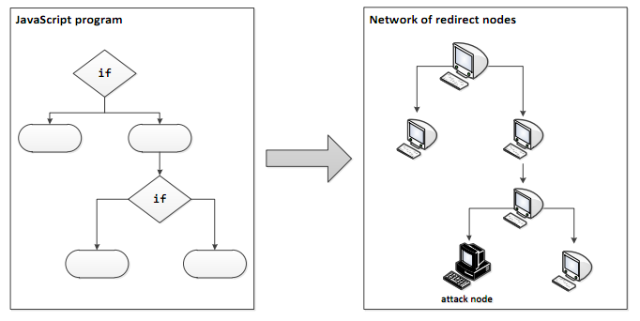
Malware Roulette

Slide 38
Related Work
Multipath
Execution
Multipath
Execution
Symbolic
Execution
Symbolic
Execution
  Cova et al, Detection and Analysis of Drive-by-Download Attacks and Malicious JavaScript Code
  Chen et al, WebPatrol: Automated Collection and Replay of Web-based Malware Scenarios
  Bisht et al, NoTamper: Automatic blackbox detection of parameter tampering opportunities in web app.s
  Eckersley, How Unique Is Your Web Browser?
  Plenty related research in binary malware analysis
  Godefroid et al, SAGE
  Saxena et al., A Symbolic Execution Framework for JavaScript
  Moser et al., Exploring Multiple Execution Paths for Malware Analysis
  Brumley et al., MineSweeper
Cloaking and
Fingerprinting
JavaScript
Analysis
JavaScript
Analysis

Slide 39
Summary
Rozzle: Multi-profile execution
  Look as vulnerable as possible
  Improve existing malware detectors
Implementation:
  Implemented on top of IE9’s JavaScript engine
  Still some flaws, promising results
Idea of multi-execution is promising in other contexts

Slide 40
Static – Dynamic Analysis Spectrum
+ High precision
- High overhead
- Low coverage
DART, SAGE
+ High precision
+ Scales reasonably well
? High coverage
+ High precision
+ High scalability
+ High coverage
- Watch out for resource usage
+ High coverage
- Low precision
- May not scale
Entirely static
Symbolic execution
Entirely runtime
Multi-execution

